Slide 1

Exception
Handling
Fundamentals of Programming
LEO GABRIEL V. VILLANUEVA, MIT
Leo Gabriel Villanueva

Slide 2
Basic Structure in Java Programming Language
1.1 Computer Systems
1.2 Programming Tools
1.3 Basic Steps in Problem Solving
  Problem Definition
  Problem Analysis
  Algorithm Design & Representation (Flowcharting)
1.4 Coding & Debugging

Slide 3
Coding and Debugging
Programming is not just about typing fast in a dark room; it is fundamentally about problem-solving.
Our goal is to learn how to break massive, complex problems down into small, logical steps that a computer can execute.
The computer is incredibly fast, but incredibly literal—it only does exactly what you tell it to do.

Slide 4
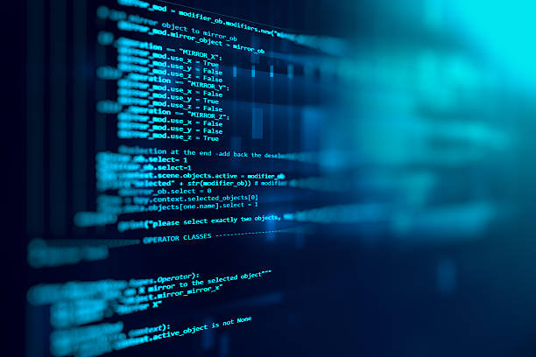
Coding (The Act of Creation)
Coding is the process of translating human logic and instructions into a formal language that a computer can execute.
For beginners, mastering coding means understanding both the rules of the language and the logic of problem-solving.

Slide 5
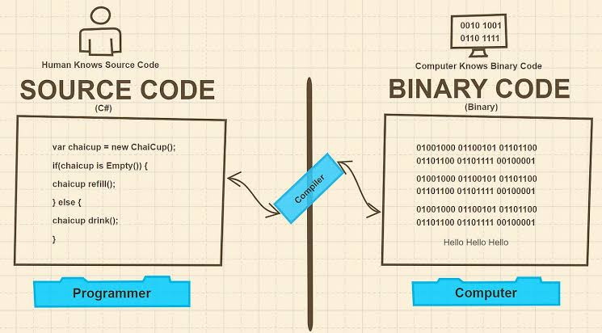
The Anatomy of Code
Source Code vs. Machine Code

Slide 6
The Anatomy of Code
Source Code vs. Machine Code
Source Code: The human-readable instructions you type into your editor (using languages like Java, JavaScript, Python, or C++).
Machine Code: The binary (1s and 0s) that the computer's CPU actually understands. Bytecode (.class file): The Java Compiler (javac) translates your code into an intermediate format called Bytecode.
The Translator: A compiler or interpreter acts as the middleman, translating your human-readable source code into machine code so the computer can execute it. The JVM (Java Virtual Machine): The JVM reads the bytecode and translates it into the specific machine code for whatever device you are using (Windows, Mac, Linux).

Slide 7
The Anatomy of Code
Variables (The Data Containers)
  Think of variables as labeled boxes in the computer's memory. You give the box a name, and you put something inside it.
  String: Text (e.g., "Hello, Pangasinan!")
  Integer: Whole numbers (e.g., 42)
  Boolean: True or False (e.g., true)
Java is a statically typed language. This means you cannot just create a variable; you must tell Java exactly what type of data it will hold, and you cannot change that type later.

Slide 8
The Anatomy of Code
Control Structures (The Brains of the Operation)
Code normally runs straight down, line by line. Control structures allow your program to make decisions or repeat tasks.
Conditionals (if/else): Tells the program to branch based on a condition.
Example: if (studentGrade >= 75) { System.out.println("Pass"); } else {
System.out.println("Fail"); }
Loops (for, while): Automates repetitive tasks. If you need to print 100 student records from a database, you don't write 100 lines of code; you write one loop that runs 100 times.

Slide 9
The Anatomy of Code
Syntax vs. Semantics:
Syntax refers to the spelling and grammar rules of a specific programming language (e.g., remembering to put a semicolon at the end of a line in PHP or JavaScript).
Semantics refers to the actual meaning or logic behind the code. Code can have perfect syntax but flawed semantics.

Slide 10
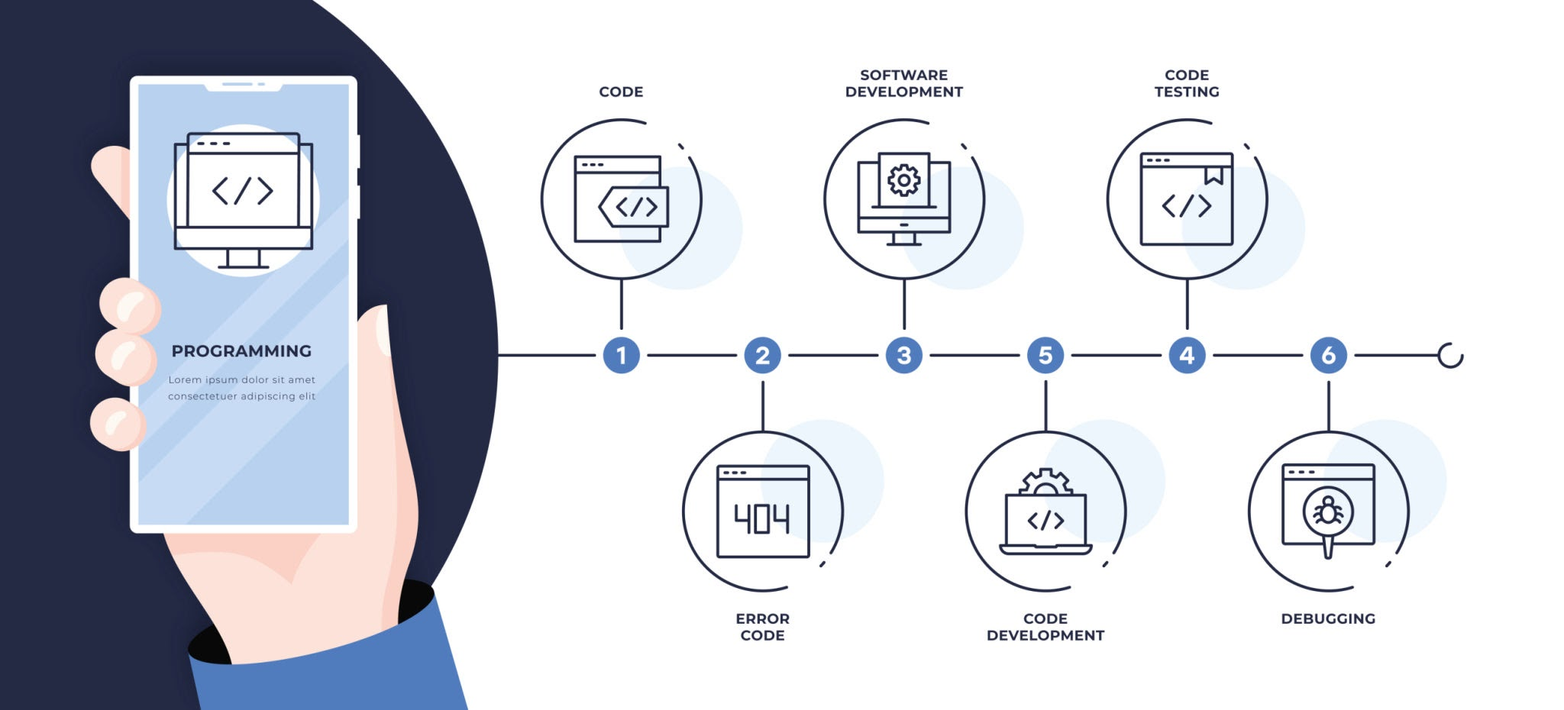
The Art of Debugging
If coding is writing a manual, debugging is figuring out why the person reading the manual built the furniture upside down. It is the methodical process of identifying, isolating, and fixing errors (bugs) in the code.

Slide 11
The Art of Debugging
Many first-year students panic when their code breaks. Do not panic. Breaking code is normal. Professional developers spend roughly 20% of their time writing new code and 80% of their time debugging it.
Debugging is the methodical process of hunting down and fixing errors (bugs) in your code.

Slide 12
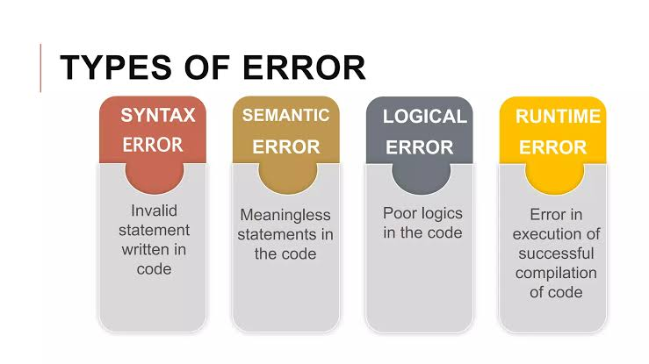
The Art of Debugging

Slide 13
The Art of Debugging
The Types of Errors
Syntax Errors: The grammar mistakes. You forgot a semicolon ;, you missed a closing bracket }, or you misspelled a command like fucntion instead of function. The program will refuse to run until you fix this.
Runtime Errors: The code looks grammatically correct, but asks the computer to do something impossible while it's running—like dividing a number by zero, or trying to connect to a database that is offline. The program runs, then crashes.
Logical Errors: The most dangerous type. The program runs perfectly without crashing, but the math or logic is wrong. (e.g., You accidentally put a + instead of a -, so a student's tuition fee is calculated incorrectly). The computer did exactly what you asked, but your instructions were flawed.

Slide 14
The Developer's Debugging Workflow
When you encounter an error in your lab exercises or projects, follow this exact sequence rather than guessing:
1.Read the Error Message : Don't just close the pop-up.
Error messages look scary, but they are your best friend. They usually tell you exactly what file and what line number caused the crash. Look for keywords like "Unexpected token" or "Null Reference".

Slide 15
The Developer's Debugging Workflow
2.Isolate the Code:
Use System.out.println(); right before the crash happens to print out the values of your variables. If you expect a variable to hold "10" but it prints "0", you've found the source of your logical error.

Slide 16
The Developer's Debugging Workflow
3.Rubber Duck Debugging : Explain it out loud.
A famous industry technique: explain what your code is supposed to do line-by-line out loud (even to an inanimate object like a rubber duck). Forcing your brain to verbalize the logic often reveals the flaw.

Slide 17
Pretest : Introductory Concepts to Programming
4.Change One Thing at a Time:
If you change five lines of code at once and the program suddenly works, you won't know which change actually fixed the bug. Test your fixes incrementally.

Slide 18
THANK YOU

